Slide 1
SCAFFOLD 3
PRECIOUS VIZCONDE
EMPOWERMENT TECH.

Slide 2
10
Multiple choice items
Topic: ICT

Slide 3
INSTRUCTION
Click the words after the letter of your answer to the questions
After answering click the number for your next question

Slide 4
QUESTIONS
BASIC ICT

Slide 5
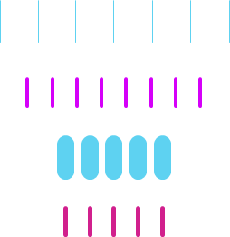
QUESTION 1
What does ICT stand for?
Innovative Compartment Technology
Imaginative Computer Technology
Information and Communications Technology

Slide 6
QUESTION 2
Who is the father of ICT?
Jhon Mike Edward
Claude Elwood Shannon
Akashi Seijuro

Slide 7
QUESTION 3
What is composed of millions of small computer
Networks all brought together to form the vast
“Inter-work”.
Internet
Mobile Network
Wi-Fi

Slide 8
QUESTION 4
What is not a trend in Ict?
Social media
Mobile technologies
Smart art technology

Slide 9
QUESTION 5
What is the synergy of technological
advancements to work on a similar goal or task?
Convergence
Combination
Familiarity Technology

Slide 10
QUESTION 6
Which of the following statements is NOT
correct ?
Computer is capable of processing only digital signal
Appropriate software is required for processing the data
Computer is capable of processing digital as well as analog signals

Slide 11
QUESTION 7
Which of the following statements is correct?
Virus is a part of software
Virus is an operating system
Internet does not allow the virus to spread

Slide 12
QUESTION 8
Line access and avoidance of collision are
the main functions of:
Wide area networks
Network protocols
The CPU

Slide 13
QUESTION 9
Information and Communication Technology
Includes:
Online learning
Web based learning
Both A. and B.

Slide 14
QUESTION 10
the hypermedia database, information bits
are stored in the form of:
Cube
Signals
nodes

Slide 15
Score chart
5
6
8
10
DECENT
GOOD
WELL DONE !
EXCELLENT !
==
==
==
==

Slide 16
finished
Thank you for answering !!
Have a good day and keep safe ☺

Slide 17
CORRECT !!!
Click if finished
1 2 3 4 5 6 7 8 9 10

Slide 18
WRONG ☹
Click if finished
1 2 3 4 5 6 7 8 9 10

